Slide 1
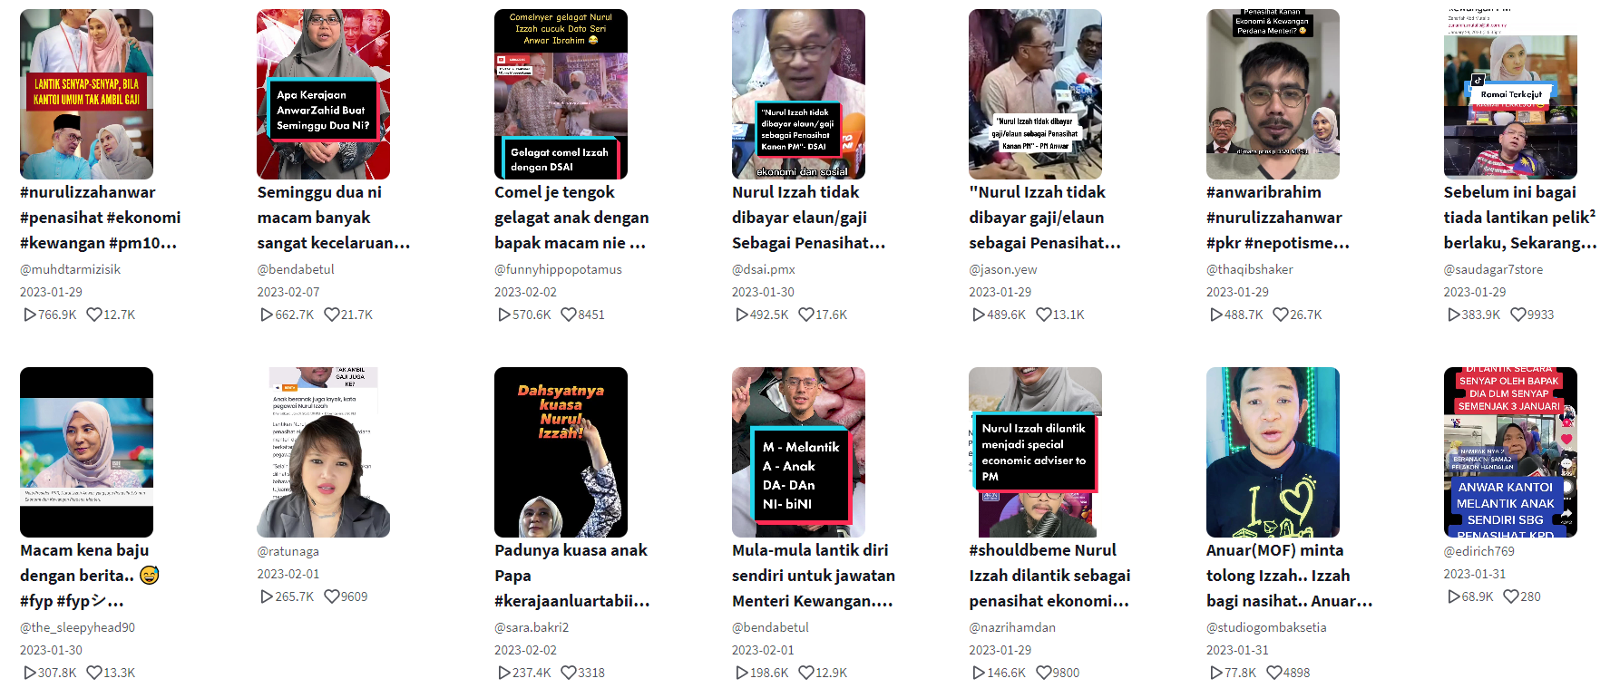

Slide 2

Principle
Principle
Nepotism
Nepotism
Nepotism
Nepotism
Principle
Principle
Credibility/Merit
Nepotism

